Slide 1
CHAPTER 2: Marketing Foundations: Global, Ethical, sustainable
Copyright © McGraw-Hill Education. All rights reserved. No reproduction or distribution without the prior written consent of McGraw-Hill Education.
McGraw-Hill Education
Part 1: Discover Marketing Management

Slide 2
Learning Objectives
Identify the various levels in the Global Marketing Experience Curve.
Learn the essential information components for assessing a global market opportunity.
Define the key regional market zones and their marketing challenges.
Describe the strategies for entering new global markets.
Recognize key factors in creating a global product strategy.
Learn the importance of ethics in marketing strategy, the value proposition, and the elements of the marketing mix.
Recognize the significance of sustainability as part of marketing strategy and the use of the triple bottom line as a metric for evaluating corporate performance.

Slide 3
Marketing Is Not Limited By Borders
Worldwide distribution networks, sophisticated communication tools, greater product standardization, and the Internet have opened world markets.
Large and small companies do business globally.
Opportunities are greater than ever but so are risks.
Global customers needs may lead to product adaptation.
Notes:
While the opportunities have never been greater, the risks have also never been higher. Global marketing mistakes are expensive. The international competitive landscape includes sophisticated global companies as well as successful local organizations. The operating environment varies dramatically around the world creating real challenges for companies moving into new markets. Global customers demand different products, which means that successful products in a company’s local market frequently have to be adapted to new markets.

Slide 4
The Global Experience Learning Curve
Four distinct stages:
No foreign marketing
Foreign marketing
International marketing
Global marketing
Notes:
The global experience learning curve moves a company through four distinct stages: no foreign marketing, foreign marketing, international marketing, and global marketing. The process is not always linear; companies may, for example, move directly from no foreign marketing to international marketing without necessarily engaging in foreign marketing. In addition, the amount of time spent in any stage can vary; some companies remain in a stage for many years.

Slide 5
Companies with No Foreign Marketing
Companies with no direct foreign marketing may still do business with international customers through intermediaries or limited direct contact.
They may fulfill unsolicited orders but these are incidental.
Notes:
Of course, any company with a website is now a global company as someone can visit the site from anywhere in the world, but companies with no foreign marketing consider any sales to an international customer as incidental.

Slide 6
Companies with Foreign Marketing
Company follow existing customers into foreign markets.
Develops local distribution and service representation:
By using local intermediaries.
Or by establishing its own direct sales force.
Key activities are done in the home country but modified for international markets.
Notes:
Global markets are important enough for management to build international sales forecasts, and manufacturing allocates time specifically to international production. At this point, international markets are no longer an afterthought but, rather, an integral, albeit small, part of the company’s growth model.

Slide 7
International Marketing
Firm begins to manufacture products outside the home market.
Global markets are essential to corporate growth.
Firm establishes an international business division or unit.
Management may still have a “domestic first” mindset.
Notes:
International marketing aligns the company’s assets and resources with global markets, but, in the vast majority of companies, management still takes a “domestic first” approach to the business. As a result, the corporate structure still divides international and domestic markets.

Slide 8
Global Marketing
Global marketing firm views the world as a single market with many different segments.
Fifty percent or more of revenue comes from international markets.
Global marketing firms see segments that may or may not align with country boundaries. International marketing firms define markets along traditional political boundaries.
Moving to global marketing depends on research critical for decision makers.

Slide 9
Ten Examples of Global Companies and their Expansion in Global Markets
EXHIBIT 2.2
Years to Expansion | U. S. Company | First Expansion
29 | Wal-Mart (est. 1962) | 1991 - Wal-Mart opens two units in Mexico City.
20 | Hewlett-Packard (est. 1939) | 1959 – HP sets up a European marketing organization in Geneva, Switzerland, and a manufacturing plant in Germany.
26 | Tyson Foods (est. 1963) | 1989 - Tyson establishes a partnership with a Mexican poultry company, to create an international partnership.
25 | Caterpillar (est. 1925) | 1950 – Caterpillar Tractor Co. Ltd. in Great Britain is founded.
19 | Home Depot (est. 1979) | 1998 – Home Depot enters the Puerto Rican market followed by Argentina.
18 | Gap (est. 1969) | 1987 - The first Gap store outside the United States opens in London on George Street.
12 | Goodyear (est. 1898) | 1910 - Goodyear’s Canadian plant opens.
10 | FedEx (est. 1971) | 1981 - International delivery begins with service to Canada.
1 | PepsiCo (est. 1965) | 1966 - Pepsi enters Japan and Eastern Europe.

Slide 10
The Global Experience Learning Curve
There are five components of essential information that relate to global marketing experience and international expansion:
Economic environment
Culture and societal trends
Business environment
Political and legal changes
Specific market conditions
Notes:
Economic environment. An accurate understanding of the current economic environment, such as gross domestic product (GDP) growth, inflation, strength of the currency, and business cycle trends, is essential. Also, depending on the company’s target markets (consumer or business), additional economic data on consumer spending per capita (consumer products) or industrial purchasing trends (business products) are also needed to facilitate decision making.
Culture, societal trends. Understanding a global market’s culture and social trends is fundamental for consumer products and helpful for business-to-business marketers. Cultural values, symbols and rituals, and cultural differences affect people’s perception of products while B2B companies must learn local cultural practices to recruit employees and establish good business relationships.
Business environment. Knowledge of the business environment is essential for companies moving into foreign markets where they will invest significant resources. Ethical standards, management styles, degree of formality, and gender or other biases are all critical factors that management needs to know before entering a new market.
Political and legal changes. Local political changes can create significant uncertainties for a business. Developing countries frequently limit the flow of money out of a country, making it harder for a foreign company to transfer money back home. Labor laws also vary widely around the world
Specific market conditions. Before entering a foreign market, a company has some understanding of the specific market conditions for its own products as a result of its existing business knowledge. However, it is unlikely a company has in-depth knowledge about market trends, competitors, and unique market characteristics.

Slide 11
Emerging Markets
For most of the Twentieth Century, world economic growth came from the Triad (Western Europe, the United States, and Japan).
For the past 25 years, growth has been in emerging markets.
Seventy-five percent of growth will come from emerging markets, mainly China and India.

Slide 12
Multinational Regional Market Zones
Multinational regional market zones consists of a group of countries that create formal relationships for mutual economic benefit through lower tariffs and reduced trade barriers (for example, NAFTA and the European Union).
They usually form as a result of four forces: economic factors, geographic proximity, political factors, and cultural similarities.
Notes:
Economic By enlarging the trading area and creating a market zone, each country benefits economically and the market zone has more power in the global marketplace.
Geographic proximity Transportation and communication networks are more likely to connect countries close to one another, making it easier to facilitate market zone activities. Other issues such as immigration also tend to be handled more effectively when the distance between partners is minimized.
Political Closely related to increased economic power is increased political clout, particularly as smaller countries form broad political alliances. A prerequisite for effective political alliances among countries is general agreement on government policies. Countries with widely disparate political structures find it difficult to accommodate those differences in a political alliance.
Culture similarities, such as having a shared language, among alliance partners also facilitate markets zones as shared cultural experiences encourage greater cooperation and minimize possible conflicts from cultural disparities.

Slide 13
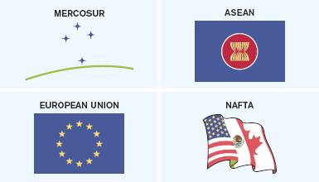
Top Four Regional Market Zones
EXHIBIT 2.7
Link to long alt text description
Reprinted Courtesy of European Commission
Notes:
Mercosur, the most powerful market zone in South America, was inaugurated in 1995 and includes the economies of South America: Argentina, Bolivia, Brazil, Chile, Paraguay, and Uruguay. With over 200 million people and a combined GDP of more than $1 trillion, it is currently the third-largest free trade area in the world.
ASEAN (Association of Southeast Asian Nations) was founded in 1967 and comprises 10 countries in the Pacific Rim (Brunei Darussalam, Indonesia, Malaysia, Philippines, Cambodia, Laos, Myanmar, Singapore, Thailand, and Vietnam). After the 1997–1998 Asian financial crisis, the group added China, Japan, and South Korea. While the relationships with these “plus 3” countries are less developed than the full member countries, the combined economic activity of all participants makes ASEAN a powerful global economic force.
Europe The European Union is the most successful regional market zone and it is also one of the oldest. Founded more than 50 years ago by six countries (Belgium, France, Italy, Luxembourg, the Netherlands, and West Germany) with the Treaty of Rome, the EU now includes 28 countries spanning all of Europe. One of the most difficult challenges for many member states is meeting targeted government spending and total debt limits. The EU has become one of the most dominant economic entities in the world, with economic output exceeded only by the United States, and its currency, the euro, is one of the leading world currencies. The European Union’s influence extends far beyond economics because member countries grant the EU significant political and social power to enact laws, create taxes, and exert tremendous social influence in the lives of citizens.
Americas The most significant market zone in the Americas is the alliance of the United States, Canada, and Mexico, which is commonly referred to by the treaty that created the alliance, NAFTA (North American Free Trade Agreement). NAFTA created the single largest economic alliance and has eliminated tariffs between the member countries for more than 19 years.

Slide 14
Select the Global Market
Deciding which countries to enter can be high risk as poor decisions lead to high costs and poor long-term investments.
Identify Selection Criteria: View competition, target market size, and growth rate. What is the size of investment? How long will it take to become profitable?
Company Review: Does the company have the personnel, managerial, and financial resources to enter the market?
Notes:
Market selection criteria incorporate the nature of the competitive environment, including both local and global competitors, as well as target market size and future growth rates. Marketing managers need to know which markets will be the easiest and which will be the most difficult to enter. In addition, the size and future growth potential of international markets is critical in making the long-term commitment to manufacture in an international market.
Moving into new foreign markets brings greater risk to the company. As a result, decision makers must consider whether their company philosophy, personnel skill sets (principally in critical areas such as marketing and logistics), organizational structure, management expertise, and financial resources support the move into new countries
Comparing the analysis of market opportunities with company characteristics drives the final selection as management looks for the best fit between each country’s mix of opportunities/threats and the company’s strengths/weaknesses.

Slide 15

Key Company Characteristics in Global Market Expansion
EXHIBIT 2.10
Philosophy
Products
Objectives
Management/
Marketing
Skills
Company
Characteristics
Resources
Financial
Limitations
Management
Style
Organization
Link to long alt text description

Slide 16
Develop Global Market Strategies: Exporting
Exporting requires minimal investment and risk.
Ten percent of all global economic activity.
The Internet has increased both domestic and international sales through the use of credit cards and other payment systems plus global delivery systems like FedEx and UPS and DHL. Amazon has gone global.
Exporters provide expertise in global shipping.
Distributors know local market conditions best.
Direct sales force is expensive but needed with technology or high-end industrial products.
Notes:
Exporter and Distributor. The next of level of exporting involves having country representation, which can take several forms. Exporters are international market specialists that help companies by acting as the export marketing department. They generally do not have much contact with the company, but exporters provide a valuable service with their knowledge of policies and procedures for shipping to foreign markets. For small companies with little or no international experience, exporters expedite the process of getting the product to a foreign customer.
Distributors represent the company and often many others in foreign markets. These organizations become the face of the company in that country, servicing customers, selling products, and receiving payments. In many cases, they take title to the goods and then resell them. The primary advantages are that distributors know their own local markets and offer a company physical representation in a global market, saving the company from committing major resources to hire and staff its own operations. The disadvantages are lack of control since distributors do not work directly for the company and lower profitability resulting from the distributor’s markup.
Direct Sales Force. Staffing a direct sales force in foreign markets is a significant step for a company moving into global markets. It is expensive to staff and maintain a local sales team in a foreign market; however, companies will often make the commitment because of the level of control and expertise offered by company-trained salespeople. For some industries, creating a direct sales force is required because customers will demand that company salespeople be in the country. This is often the case in the technology and high-end industrial product industries.

Slide 17
Market Entry Strategy: Contractual Agreements
Contractual agreements are non-equity relationships with another company, often in the target country.
Licensing: May be required by law, direct importing may be restricted, or the company has limited financial resources.
Franchising: Franchise agreements allow the firm to retain control of quality. It has low capital investment, rapid expansion, local market knowledge.
Notes:
Contractual agreements allow a company to expand participation in a market by creating enduring, nonequity relationships with another company, often a local company in that market. Most often these agreements transmit something of value such as technology, a trademark, a patent, or a unique manufacturing process in return for financial compensation in the form of a licensing fee or percentage of sales.
Licensing. Companies choose licensing when local partnerships are required by law, legal restrictions prohibit direct importing of the product, or the company’s limited financial resources limit more active foreign participation. Companies seeking to establish greater presence in a market without committing significant resources can choose to license their key asset (patent, trademark) to another company, effectively giving the company the right to use that asset in that market. Small and medium-sized companies with a specific product competence that lack the willingness or expertise to invest heavily in foreign operations can identify a license partner in a particular foreign market to manufacture products or provide critical services such as local distribution.
Franchising, as a global market entry strategy, really took off in the 1990s and has been the first point of entry for many retailers looking to expand international operations. McDonald’s, Burger King, KFC, and others have created large franchising networks around the world. Nearly two-thirds of McDonald’s restaurants are outside the United States. Combining low capital investments, rapid expansion opportunities, and local market expertise, franchising offers many advantages as a market entry strategy. However, there are also challenges. Worldwide, consumer tastes vary significantly and franchisors need sufficient resources to create products that will meet demands of global customers while maintaining quality control.

Slide 18
Market Entry Strategy: Strategic Alliances
Strategic alliances spread risk of foreign investment among partners. For example, they dominate the airline industry with oneworld, Skyteam, and Star.
International joint ventures allow companies to enter markets that would be closed because of legal restrictions or cultural barriers. They are formed by two or more companies that share management duties in a defined structure and also hold equal equity positions. They cannot be formed by individuals.

Slide 19
Market Entry Strategy: Direct Foreign Investment
Direct foreign investment is the riskiest strategy, but it offers potential for long-term growth.
The following factors are important to consider: timing, legal issues, transaction costs, technology transfer, product differentiation, and marketing communication barriers.
Notes:
Timing—unknown political or social events, competitor activity.
Legal issues—growing complexity of international contracts, asset protection.
Transaction costs—production and other costs stated in various currencies.
Technology transfer—key technologies are more easily copied in foreign markets.
Product differentiation—differentiating a product without increasing cost.
Marketing communication barriers—local market practices vary a great deal.

Slide 20
Organizational Structure Choices
Decision-making authority becomes more complicated with added layers of authority and differences in global time zones. Clearly defined protocols for decision-making are needed.
The degree of centralization affects resource allocation and personnel. Organizational structure can be centralized, decentralized, or regionalized.
Notes:
The primary advantages of a more centralized structure include greater control and, as a result, more consistency across the organization. It is also more efficient in creating centers of expertise that bring together knowledgeable people to address key organizational issues (for example, R&D, legal, and IT). Decentralized organizations, on the other hand, offer a hands-on management approach that facilitates rapid response to changing market conditions. The regional organization seeks to combine advantages of both approaches by centralizing key functions while pushing decision making closer to the global market.

Slide 21
Choose Structure
Global product lines works for firms with a broad, diverse range of products; for example, Siemens.
Geographic regions builds autonomous regional organizations that work well when local government relationships are critical; for example, Halliburton.
Matrix structure is a hybrid of the first two and is used by most global firms.

Slide 22
Product Choices
Direct product extension means no changes in the product. There are no extra R&D or manufacturing costs
Product adaptation means the product is changes to meet local market needs and legal requirements. Product changes range from regional to city levels.
Backward product invention takes a discontinued product from one market and introduces it into another.
Forward product invention creates new products for new markets.

Slide 23
Consumer Issues
Quality is viewed differently around the world.
Fitting the product to the culture is a challenge with brand names, product colors and features.
Brand strategy decisions reflect either a global, regional, or local brand.
The country-of-origin effect is the positive or negative perception of the product based on the producing country.
Notes:
Quality The perception of quality varies drastically around the world, which makes it hard for a company developing or adapting a product for a global market. What works in one market may fail in another, as cell phone manufacturers have learned. In Europe, Japan, and the United Sates, cell phones must have a roaming capability to be successful, but Chinese consumers do not consider it an important feature.
Fitting the Product Language differences have created unique and occasionally humorous examples of marketing mistakes. When Coca-Cola introduced Diet Coke in Japan, initial sales were disappointing until the company realized that Japanese women do not like the concept of dieting and the Japanese culture relates dieting to sickness (not a desired connection with a product). The company changed the name to Coke Light, which has been much more effective around the world.
Brand Strategy Companies often seek to create a unified branding strategy around the world. In some cases this is effective. Coca- Cola, Caterpillar, Apple, Kellogg, BMW, and others have created powerful global brands. As companies acquire local brands, one of the first decisions is whether to fold a local brand into a global brand. Companies have to consider local conditions, but, when possible, companies are harmonizing brands to build brand awareness and extend marketing communication dollars.
The country-of-origin effect is the influence of the country of manufacture, assembly, or design on a customer’s positive or negative perception of a product.31 “Made in Japan,” “Made in Italy,” “Made in the United States”—each has meaning to customers and infers that a product has certain qualities based on its country of origin. Such perceptions can change over time.

Slide 24
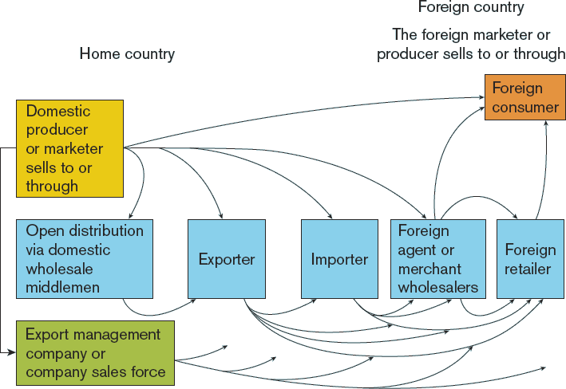
International Channel Structures
EXHIBIT 2.11
Link to long alt text description
Reprinted from Philip R. Cateora and John L. Graham, International Marketing, 13e, 2007.

Slide 25
Market Channel Issues
Channel factors include cost, capital, control, coverage, character, and continuity.
Notes:
Cost Estimating channel costs includes: (1) the initial investment in creating the channel and (2) the cost of maintaining the channel. As companies expand into new markets, many search for ways to increase the efficiency of local distribution systems by eliminating unnecessary middlemen, thereby shortening the channel to the customer.
Capital An inadequate global market distribution system is expensive both in terms of adding cost to the product and creating long-term damage to the brand and the company’s reputation. If a channel network is already in place, the investment is low; however, if the company needs to develop or greatly improve an existing system, the cost can be very high.
Control The more control the company wants in the channel the more expensive it is to maintain. As a result, companies generally look for a balance between channel control and cost. The complexity of global supply chains coupled with lack of local market knowledge make the task of creating a distribution system so expensive that all but the most accomplished global marketers rely on local distribution networks in foreign markets.
Coverage Local distribution networks around the world may lack full exposure to a given market. Even in the United States, for example, complete coverage of a consumer market necessitates multiple distribution channels. As a result, it is necessary to evaluate which distribution network best reaches the target customers, which may not necessarily be the network with the widest distribution. Targeting upper- and middle-class consumers in China requires extensive distribution in cities along the coast (Beijing, Shanghai, and Guangzhou) but minimal distribution in the rest of the country.
Character The long-term nature of channel decisions makes character an issue in selecting the best channel partner. The capabilities, reputation, and skills of the local channel partner should match the company’s characteristics. A service-oriented company should look for local channel partners with a reputation for excellent service and high customer satisfaction.
Continuity Changing a distribution system creates anxiety among customers and gives competitors an opportunity to take advantage of inevitable inefficiencies and disruption of service. Identifying channel partners with a long-standing presence in the market provides some security; however, the best local partners are also the most difficult to establish a relationship with as they frequently already have established involvement with competitors.

Slide 26
Marketing Communications: Advertising
Four advertising strategies:
Global marketing themes.
Global marketing with local content.
Basket of global advertising themes.
Local market ad generation.
Notes:
The first strategy creates global marketing themes adjusting only the color and language to local market conditions. The basic ad template remains unchanged throughout the world. A second strategy, global marketing with local content, keeps the same global marketing theme as the home market but adapts it with local content. Local content is incorporated in a standardized template to encourage a local look and feel to the ad. This includes images as well as written copy, but the ad still relates to the same global marketing message. A third approach is a basket of global advertising themes. Here related but distinct ads built around several marketing messages are generated, often by the company’s lead advertising agency, and local marketers select the ads that best fit their specific market situation. Finally, some companies allow local market ad generation. Marketers have the authorization to create local ads that do not necessarily coordinate with global marketing messages. However, this strategy still requires coordination at higher levels in the company to ensure consistent quality.

Slide 27
Other Marketing Communications
Personal selling: Companies need sensitivity in selecting, hiring, and training their global sales force to accommodate local business cultures.
Sales promotion: The need to stimulate consumer trial and purchase can be greater outside the U.S.
Public relations: The expansion of global communications has greatly increased the importance of international public relations.
Notes:
Personal Selling The salesperson–customer relationship is dramatically different around the world. In the United States, the relationship is very business- focused and less personal. In Latin America and Asia, the relationship is much more personal. Actual business negotiations often do not begin until a personal relationship has been established. Companies need sensitivity in selecting, hiring, and training their global sales force to accommodate local business cultures.
Sales Promotion A relatively small part of U.S. marketing communication budgets is allocated to sales promotion; however, this can be a significant component of marketing communication strategy in global markets. The need to stimulate consumer trial and purchase can be greater. Both PepsiCo and Coca-Cola sponsor traveling carnivals to outlying villages in Latin America with the purpose of encouraging product trial.38
Public Relations The expansion of global communications has greatly increased the importance of international public relations. Companies realize that dealing with crises must be done quickly and effectively as global news organizations move instantly on stories around the world. Getting the company’s perspective on a story requires coordination by the company and public relations consultants before release to the public. Public relations can also enhance other elements of a marketing communications strategy. When companies introduce new products, they frequently schedule them to coincide with press conferences and news cycles in other countries.

Slide 28
Pricing
With a one-world price, the company assigns one price for its products in every global market. Examples include oil and diamonds.
A local-market-conditions price reflects the response to competitors in the local area.
A cost-based price does not reflect local conditions and is based on cost-plus-final markup.
Notes:
One World Price The company assigns one price for its products in every global market. In theory, this approach enables a company to standardize other elements in the marketing mix and simplifies financial forecasting. In reality, this strategy is not followed very often. While price is constant, the cost to produce, distribute, and market the product varies dramatically, creating wide fluctuations in profit margins.
Local Market Conditions Price The company assigns a price based on local market conditions with minimal consideration for the actual cost of putting the product into the market. Responding to the market is certainly vital in assigning the final price, but local conditions may not reflect the reality of bringing the product to market for an international company. Local competitors do not incur the transportation costs, potential tariffs, and other related expenses of bringing a product in a foreign market. As a result, companies must be particularly sensitive to local market pricing when setting their price.
Cost-Based Price This strategy considers cost plus markup to arrive at a final price. While the focus on costs precludes charging an unprofitable price, it does not consider actual market conditions. If costs are high as a result of tariffs or transportation, the final price may be too high for the market.

Slide 29
Price Escalation
Product export costs.
Tariffs, import fees, taxes.
Exchange-rate fluctuations.
Middlemen and transportation costs.
Notes:
Price escalation occurs when products are moved from the home market to the target country.
Product export costs: Differences in the product configuration, packaging, and documentation raise the cost of many products for international markets. A key internal cost issue is transfer pricing, or the cost companies charge internally to move products between subsidiaries or divisions. If companies charge too high a price internally, it can make the final product price uncompetitive because the local subsidiary must add a markup to arrive at a final price.
Tariffs, import fees, taxes: Governments all around the world impose tariffs, fees, and taxes on imported products to protect industries in their home market and increase their revenue.
Exchange rate fluctuations: For many years, the U.S. dollar was the standard for all international contracts, which tended to minimize currency fluctuations as everything was priced in dollars. Now, currencies float and products are priced using a market basket of currencies. Since currencies can easily float 15 to 20 percent against each other, the assigning of currency values in international contracts is critical. Increasingly, companies want contracts written in their home currency to protect their risk of loss due to currency fluctuations.
Middlemen and transportation costs: Creating a channel for global markets extends the number of channel members and increases costs. Each channel partner requires compensation, which raises the final price to the customer. Moreover, transportation costs increase as the distance to a local market increases.

Slide 30
Global Pricing Issues
Dumping refers to the practice of charging less than actual costs or less than the product price in the company’s home markets.
Gray Marketing involves the unauthorized diversion of branded products into global markets. Gray markets distributors (who are often authorized distributors) divert products from low-price to high-price markets.
Notes:
Global pricing issues In addition to price escalation, there are two other global pricing issues. The first, dumping, refers to the practice of charging less than actual costs or less than the product price in the company’s home markets. The World Trade Organization and most national governments have outlawed this practice and, if dumping is proven, a government can impose a tax on those products. Dumping is generally not a problem when global markets are strong; however, the willingness to price export goods based on marginal costs rather than full costs increases when markets weaken. The second major issue is the gray market, which involves the unauthorized diversion of branded products into global markets. Gray market distributors (who are often authorized distributors) divert products from low-price to high-price markets. Companies should carefully watch unusual order patterns among their distributors because that can signal a gray market problem.

Slide 31
Ethics: At the Core of Successful Marketing Management
Ethical leadership, culture, and policies are essential for ethical decision making. One example of ethical failure is Volkwagen’s deception of emission reporting cost the firm billions of dollars.
Ethics in marketing is key to establishing and maintaining customer relationships.
Legal requirements are the baseline for marketing ethics.
Notes:
Some argue that companies only need to meet legal obligations in their marketing activities. However, successful marketers today understand that the law is only the “baseline” of expected behavior and generally lags behind societal norms and opinion. In some respects, this is good, as opinions can change quickly and companies need stability in strategic planning and implementation. However, following the law does not mean the company is doing all it can do or even should do in its marketing efforts. On the other hand, marketing ethics encompasses a societal and professional standard of right and fair practices that are expected.

Slide 32
Ethics and the Value Proposition
Value equals benefits divided by price.
How customers view a company’s ethics is key in evaluating the value proposition.
Once trust is broken, it is very difficult to get it back. Consider Wells Fargo’s fake accounts and Johnson & Johnson’s talcum powder being linked to ovarian cancer.
Notes:
You will recall that value is the net benefits (or costs) associated with a product or service. The buyer considers all the benefits, then subtracts all the costs, and arrives at a value for the product. One of the key considerations is the buyer’s trust or belief that the company will keep its promises with regard to the product experience, warranty, service, and a host of other interactions. When the customer does trust the company, that is a major benefit, but when trust does not exist, it is a significant cost.

Slide 33
Ethics and Elements of the Marketing Mix: Product
Use marketing research data that ensures privacy and confidentiality.
Define market segments that do not discriminate against any particular segment.
Develop products that are safe and select materials that are not harmful to users.
Manufacture products using materials that are safe for users, in conditions that are safe for employees.
Clearly define and honor warranties and service agreements.

Slide 34
Ethics and Elements of the Marketing Mix: Price
Disclose the full price to customers before purchase.
Do not engage in unethical pricing practices such as price discrimination, price fixing, or predatory pricing.
Fully disclose any other bundled pricing before customer’s purchase.

Slide 35
Ethics and Elements of the Marketing Mix: Distribution
Unfair pressure should not be put on channel members.
Channel members should not use manipulative sales techniques on other channel members.
Data privacy confidentiality should occur throughout the channel.
No channel members should exert undue pressure on customers to purchase products that are unnecessary or not needed.

Slide 36
Ethics and Elements of the Marketing Mix: Marketing Communications
No deception or misrepresentation should occur in any marketing communications to any stakeholders (customers, investors, employees).
High-pressure or manipulative sales techniques should not be used by salespeople or messaged in advertising.

Slide 37
Code of Marketing Ethics
Most companies today create a code of ethics that defines the company’s values.
The American Marketing Association’s code of ethics refers to six values: honesty, responsibility, fairness, respect, transparency, and citizenship.
Notes:
Many companies embrace ethical values similar to AMA’s in their corporate codes of ethics. At the same time, companies increasingly see a need to supplement their corporate codes of ethics with a discussion of specific ethical marketing practices. The goal is to provide clarity for marketing managers as they make critical marketing decisions that frequently involve an ethical component. The focus on ethics in marketing speaks to the essential role of marketing in the organization and the impact of ethical (and unethical) decisions on organizational performance.

Slide 38
Sustainability: Right and the Good Strategy
Doing well by doing good.
Environmental laws grew out of the problems of the Great Depression of the 1930s.
The Green movement was founded on environmental concerns and resource utilization issues and came to be known as sustainability.
Today sustainability includes issues like an educated workforce, greater connection and support of local communities, and linking policies and strategy.

Slide 39
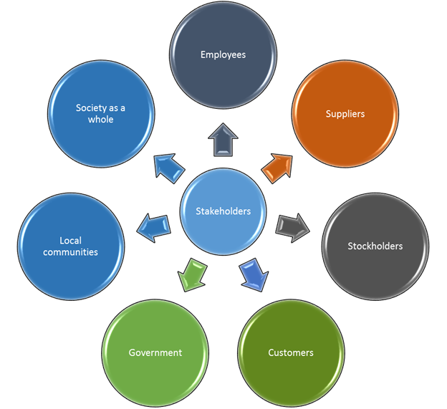
Triple Bottom Line: Stakeholders
EXHIBIT 2.13
Notes:
In Chapter 1 we identified the various groups, called marketing stakeholders, that interact with or are impacted by marketing, and they are key to understanding the triple bottom line. These stakeholders are shown again in Exhibit 2.13. Originally presented by John Elkington in his book Cannibals with Forks: The Triple Bottom Line of 21st Century Business, the triple bottom line brings accountability to the various interests of marketing (business) stakeholders. The traditional approach, financial accounting, was useful for shareholders, but what about customers, suppliers, government agencies, and many others? The triple bottom line (TBL) is a metric for evaluating not only the financial results of the company but the broader social equity, economic, and environmental considerations as well. Consider the impact of the TBL in marketing management using the people, planet, and profit approach outlined graphically in Exhibit 2.14.
Many, if not most, organizations still focus exclusively on profit as the sole metric of success. However, companies are increasingly realizing that success needs to include other metrics, like people. This type of change begins with management acknowledging that there are success objectives beyond profit, then creating metrics, strategies, and tactical plans to implement that change. From there, training and education is needed to raise employee awareness that, over time, leads to a change in culture. As marketing employees (sales, customer service, and others) are often the customer’s point of contact with the company, this becomes an important first step. Ultimately, companies today now actively look for ways to “give back” to the community. Disney, for example, allows employees time off to work with community organizations of their choice. In addition, the company will match donations from employees to community organizations.

Slide 40
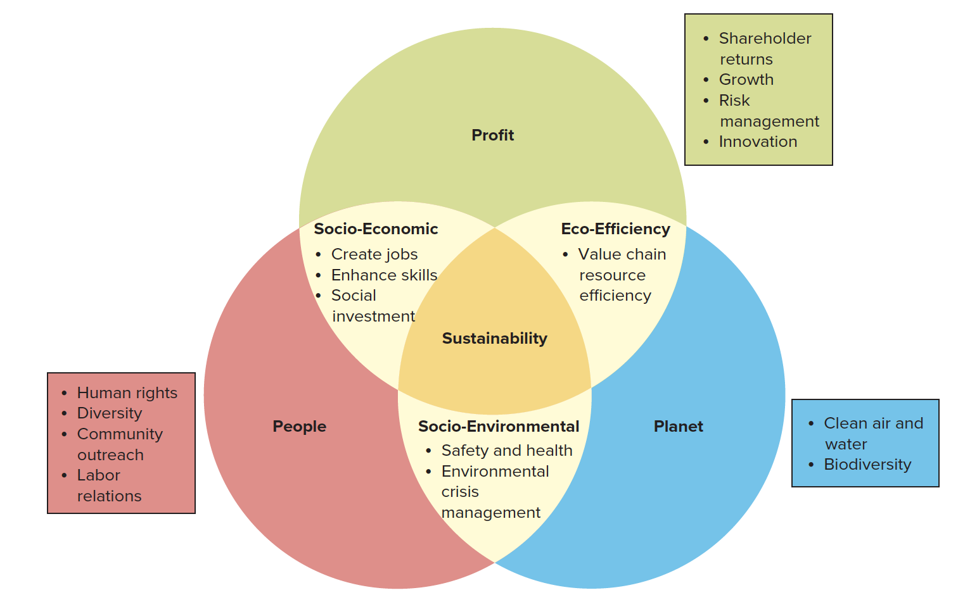
Triple Bottom Line
EXHIBIT 2.14
Link to long alt text description
Notes:
A second TBL metric is the planet, and marketers are very involved in decisions that impact the planet. From sustainable sourcing of materials to efficient, environmentally sensitive supply chains, marketers are evaluating critical processes to maximize the environmental impact while meeting corporate objectives related to cost and product quality. Over time, companies like Starbucks have been successful in developing “ethically sourced” coffee that is socially responsible and environmentally safe. The company was instrumental in creating the C.A.F.E. (Coffee and Farmer Equity) practices, which set forth guidelines around four key areas: quality, economic accountability and transparency, social responsibility, and economic leadership. Companies are accepting greater responsibility not only for their own manufacturing but for their suppliers’ business practices as well. In some cases, such as Nike, this was the result of public pressure to reduce unhealthy employee work conditions at their suppliers. Nike and others are now proactively evaluating their suppliers to maintain the same environmental standards and working conditions as they themselves do. Finally, profit remains an important metric in a sustainable company. While considering the impact of marketing decisions on people and the planet, marketing managers must still meet financial objectives for the company to be successful. For example, consider the impact of a company’s sustainability decisions on customer product choice decisions. Some target markets, such as Millennials, consider sustainability an important factor in their decision making. This means companies have to adapt their products, distribution, marketing communications, and pricing to incorporate sustainability into their overall marketing strategy. The challenge is not limited to B2C markets, but is increasingly prevalent in B2B markets as well. IBM, for example, invests heavily in a variety of sustainable activities and has won awards for its focus on the environment and sustainable development. Customers, employees, and other stakeholders—not to mention shareholders—expect companies to be able to balance profit goals and objectives with people and planet objectives.

Slide 41
Alt Text Appendix
All long alt text descriptions are included in this appendix.

Slide 42
The Top Four Regional Market Zones
Four quadrants represent the top four regional market zones showing: 1) the logo for Mercosur, 2) the logo for the Association of Southeast Asian Nations (ASEAN), 3) the flag for the European Union, and 4) a flag representing all three nations of NAFTA (the United States, Mexico, and Canada).

Slide 43
Key Company Characteristics in Global Market Expansion
Key company characteristics in global market expansion include: philosophy, objectives, resources, management style, organization, financial limitations, management and marketing skills, and products.

Slide 44
International Channel Structures
There are many channels that businesses can use to reach consumers in other countries. First, a domestic producer or marketer in the home country can sell directly to foreign consumers. Alternately, an organization in the home country can work through a foreign marketer or producer located in the country home to the target foreign consumer. A domestic producer or marketer can also opt for open distribution via domestic wholesale middlemen who rely on exporters, importers, foreign agents, merchant wholesalers, or foreign retailers. There are many different combinations of middlemen that can be used to reach global consumers. Another common option is for a domestic producer or marketer to hire an export management company or hire a company sales force to sell to consumers in another country. An export management company or company sales force may or may not rely on wholesale middlemen.

Slide 45
Triple Bottom Line
The top circle of the Venn diagram lists metrics related to profit. These metrics are shareholder returns, growth, risk management, and innovation. The lower-left part of the profit circle intersects with the people circle. This is where profit and people metrics overlap. These are called socio-economic metrics, and they include job creation, enhanced skills, and social investment. Socio-economic metrics support both profit and people. The lower-right part of the profit circle intersects with the planet circle. This is where profit and planet metrics overlap. This identifies the eco-efficiency metric, which is value chain resource efficiency. The eco-efficiency metric supports both profit and planet. The lower-left circle of the Venn diagram lists metrics related to people. These metrics address human rights, diversity, community outreach, and labor relations. The people circle also includes the socio-economic metrics, which support both people and profit. Moving to the third circle, at the lower-right of the Venn diagram, we find metrics related to the planet. Planet metrics measure clean air, clean water, and biodiversity. The planet circle also includes the eco-efficiency metric, which supports both planet and profit. At the center of the bottom is an area where the people and planet circles intersect. This area contains socio-environmental metrics, which relate to safety and health and environmental crisis management. Sustainability is at the center of the diagram, at the point where the profit, planet, and people circles overlap. It encompasses all of the different types of metrics depicted in the Venn diagram.

